Slide 1

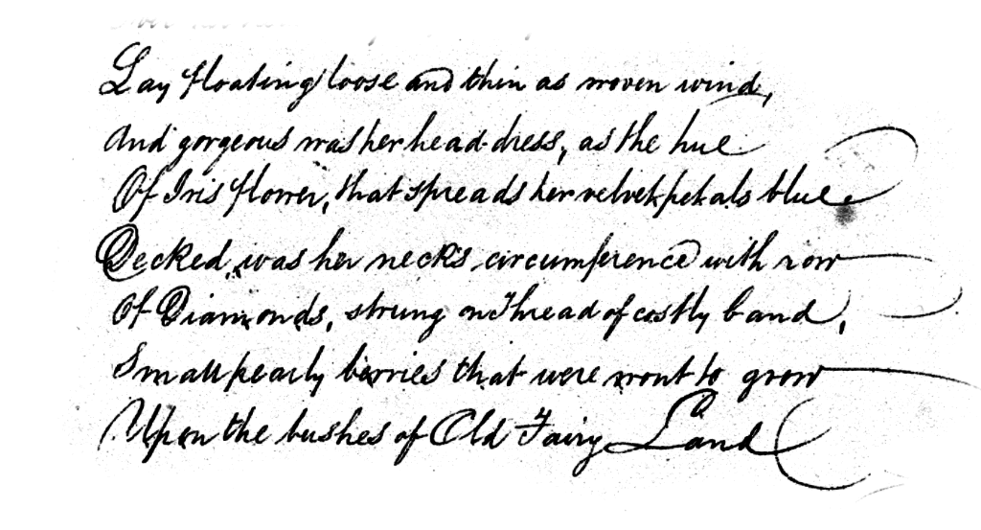

Handwriting Verification
In Biometric Systems
Mohammadreza Shabani - 1966731
Hassan Teymoori - 1947458
Thanks to Professor :
Maria De Marsico
June 2022

Slide 2
TABLE OF CONTENTS
01
Introduction
02
Data Providing & Pre-Processing
03
Training Phase
04
Evaluation
Motivation
General Architecture
Downloading Raw Dataset
Paragraphs Extracting
Image Pre-processing
Writer Selection
Split Data
Image Generation
Implementation Part
Loss and Accuracy
Feature extraction model
Comparison performances with different augmentations

Slide 3
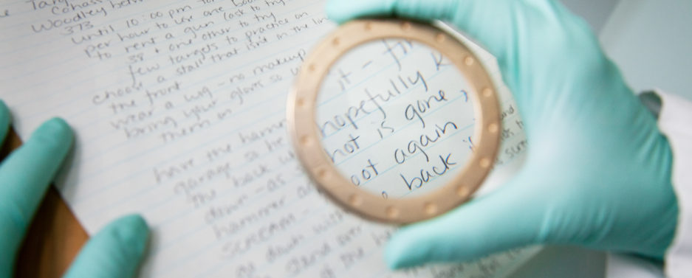
01
Introduction

Slide 4
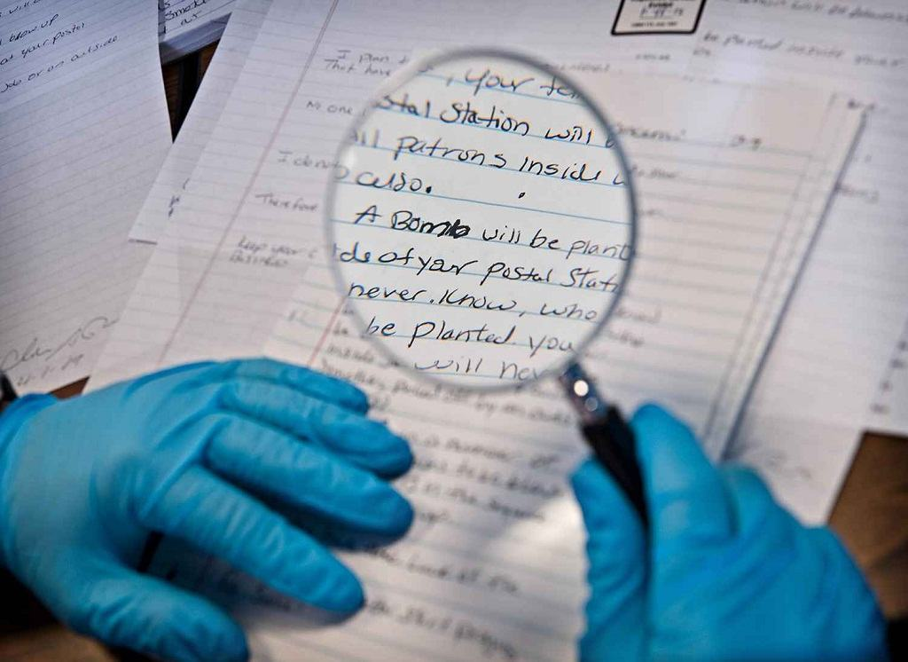
Introduction: Motivation
Help in determining the valid writer based on their handwritten text
Used in various fields like security, literature analysis, and signature analysis
Handwritten documents can be primarily divided into two classes:
Online → documents contains
the coordinates of pen movements,
pen-up and pen-down events.
etc..
Offline → documents are scanned images of handwritten documents.

Slide 5
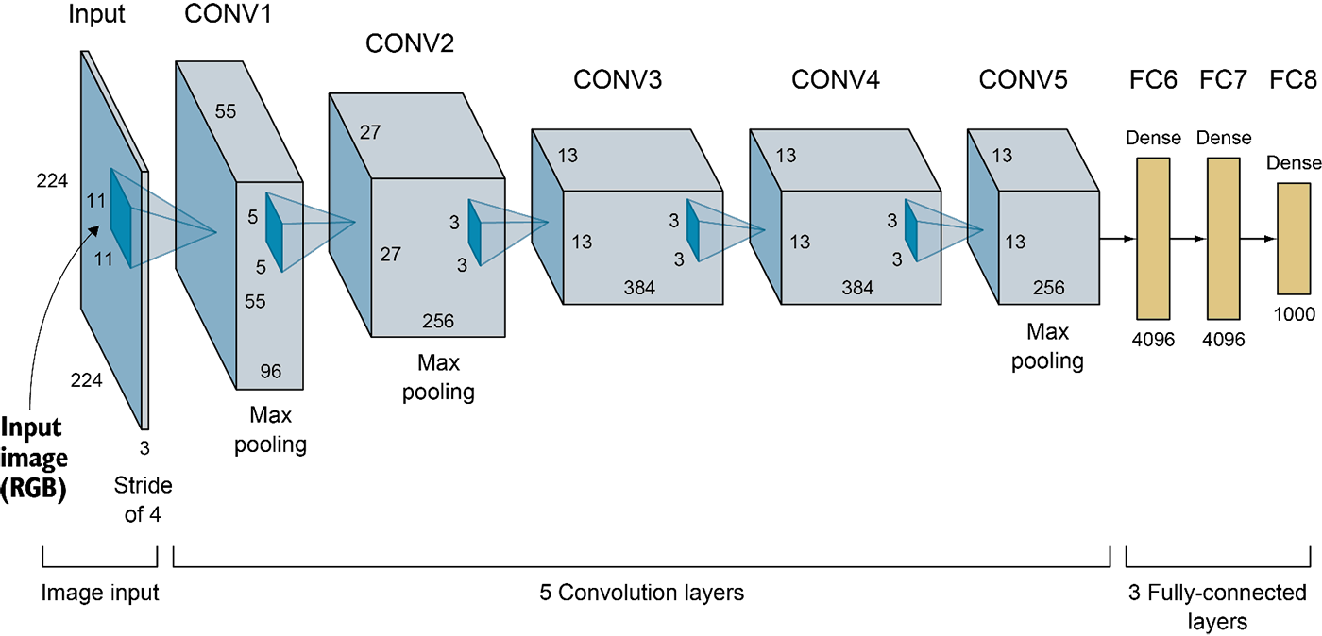
Introduction: Architecture
The project is done in three stages:
Image pre-processing to remove noise
Feature extraction using AlexNet-based CNN architecture (We changed a bit during training)
5 convolutional , 3 max-pooling, 2 normalization, 2 FC, and 1 softmax layers
Each convolutional layer consists of convolutional filters and a function ReLU
Input size is fixed due to the FC layers(224 x 224)
Verification using all-against-all multiple template approach

Slide 6
Data Providing
&
Pre-Processing
02

Slide 7
Data Providing and Image Pre-processing Procedure
Splitting
Split data into train and test set, Cropping to increase dataset
Paragraph Extracting
Using coordinates in XML files
Image Pre-processing
Using Gaussian Blur and Canny edge detector
Writer Selection
having a suitable number of train and test samples
Raw Dataset
IAM Handwriting Database
05
02
04
01
03

Slide 8
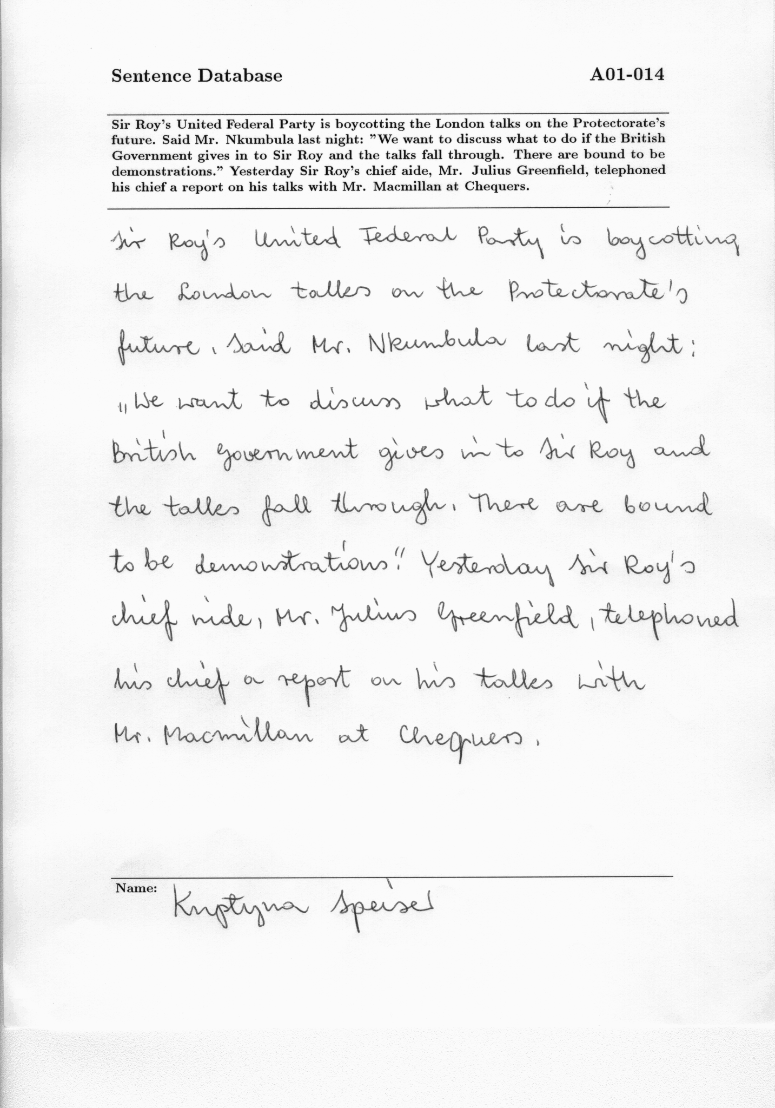
Data Providing: Raw Dataset
The IAM Handwriting Database (Link)
The database has some characteristics such as:
Images in resolution of 300dpi
PNG images with 256 gray levels
657 different writers
English text
Writer ID appears on top of the forms
XML file contains metadata

Slide 9
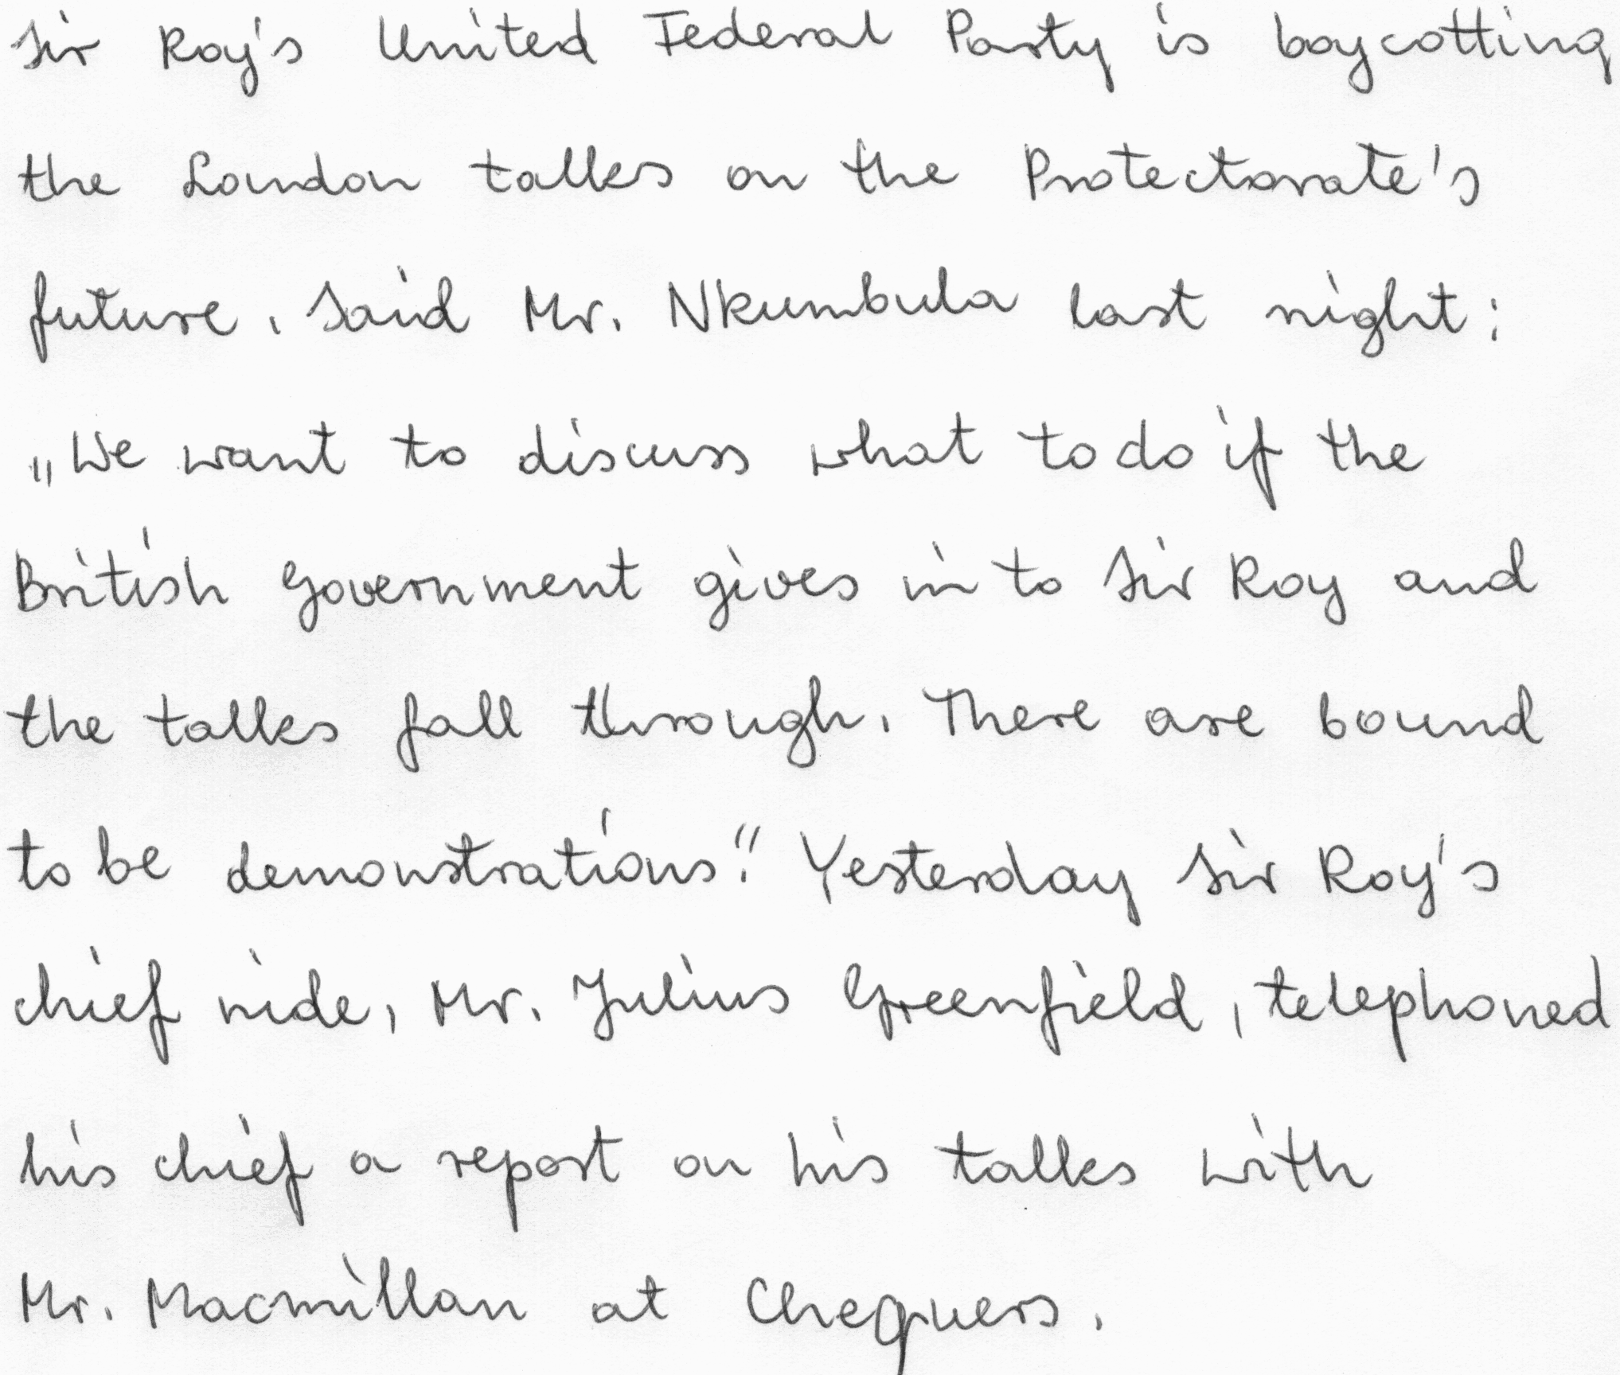

Data Providing: Paragraphs Extracting
ONLY handwritten section was extracted by using the metadata in the XML file

Slide 10
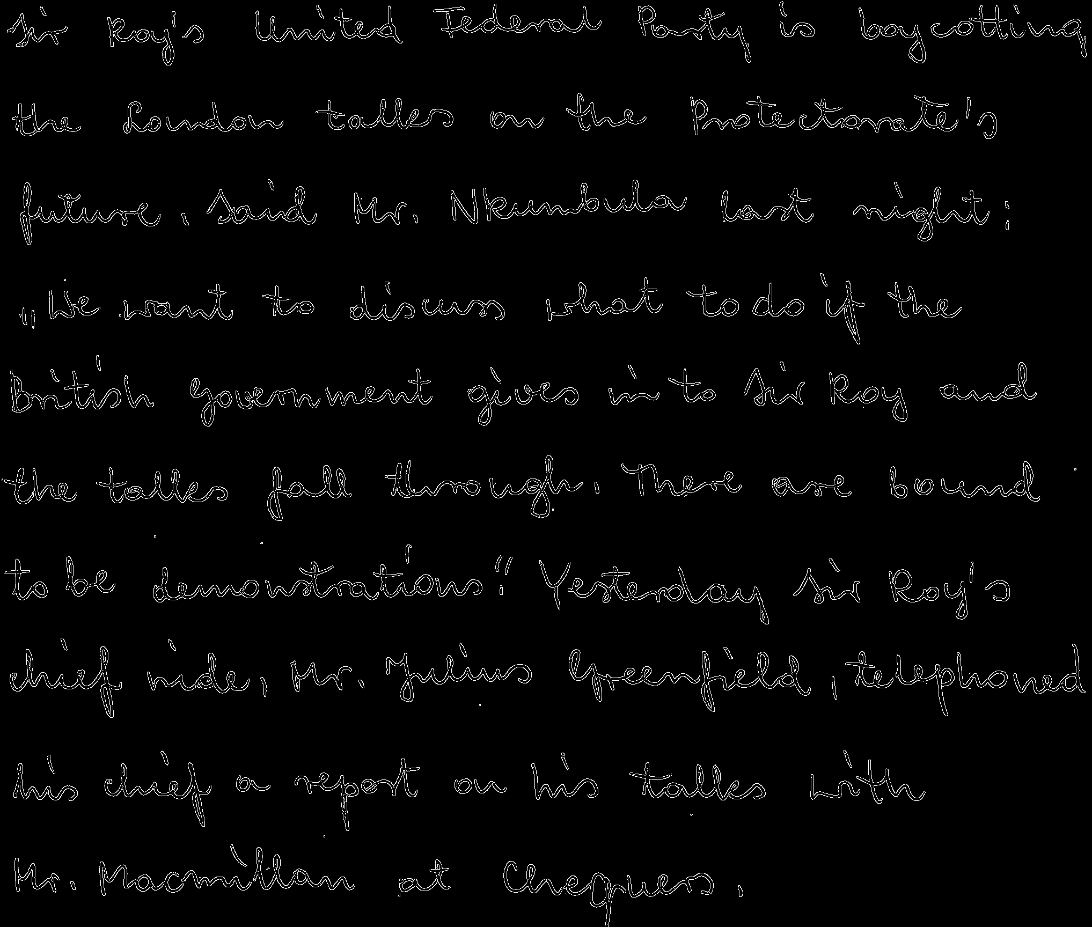
Data Providing: Image Pre-processing
Used to remove the noise and variations in background lighting.
Opencv libraries used (in order):
Gaussian blur filter
Canny Edge Detector

Slide 11

Data Providing: Writer Selection
Aim is to have a suitable number of train and test samples
The writers have been selected who have at least 9 different samples
As the result, we have 340 forms with 31 different writers

Slide 12
Data Providing: Splitting
We must consider some criteria:
Each writer must have at least one sample in the test set to be tested.
(unlike random splitting in machine learning)
A good number of training & testing samples
Since the task is to identify the writer, cropping the samples into multiple smaller ones (500 x 500) helps to increase the number of the training and testing samples
Overlapping between smaller samples:
In training set → is allowed → 8 different smaller images
In testing set → is not allowed at all → 3 different smaller images

Slide 13
Data Providing: Splitting
To prevent having an unbalanced train set, and having an equal number of documents per each identity, we took 5 forms for each identity as the training samples (before cropping)
Dataset Splitting Procedure:
Training Set → 5 out of 9 samples per each writer
Test Set → 4 out of 9 samples per each writer

Slide 14

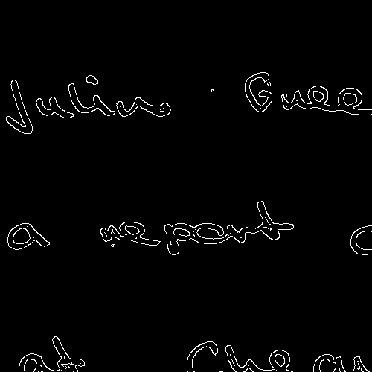
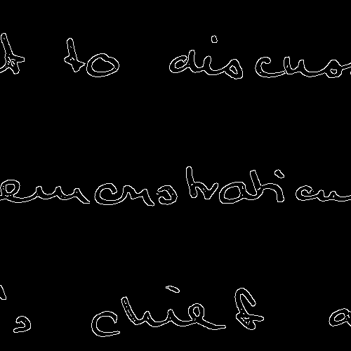
Data Providing: Splitting
In overall, in our dataset there are:
31 identities, with 9 documents for each
5 documents per each identity in the training set
4 documents per each identity in the test set
Each of the training set images cropped into 8 sub-images
Each of the test set images cropped into 3 sub-images
31 * 5 * 8 = 1240 training samples
31 * 4 * 3 = 372 test samples

Slide 15

03
Training Phase

Slide 16
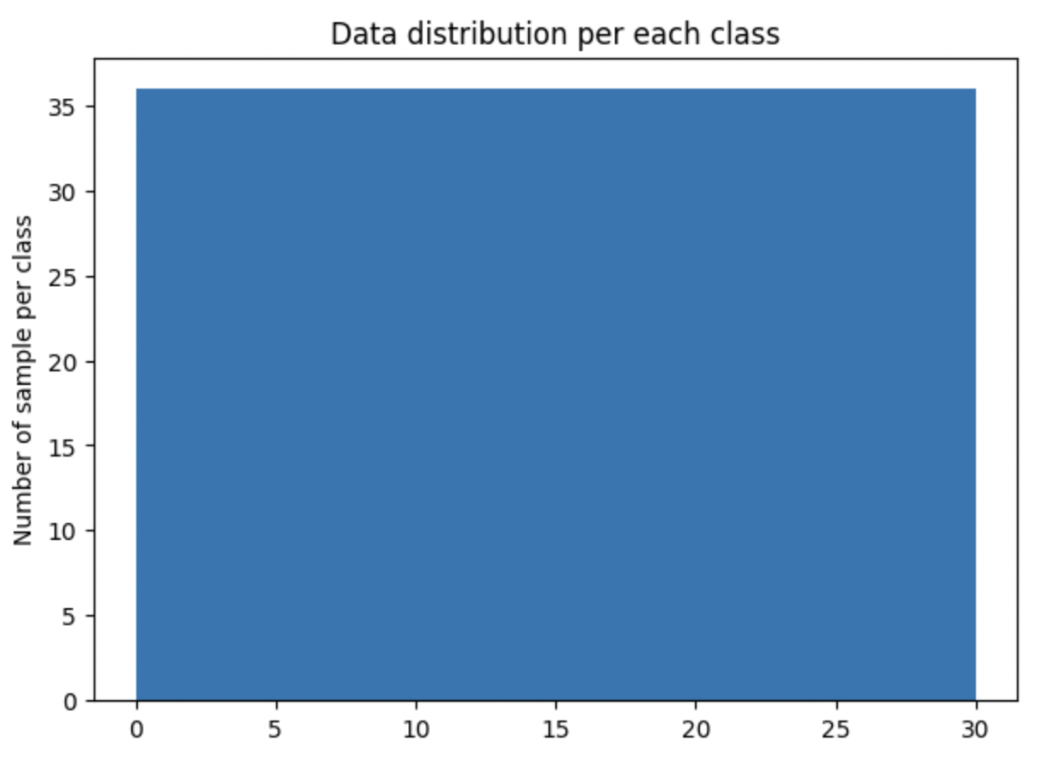
Training Phase: Image Generation
We have 3 different models w.r.t. 3 different approaches using Keras Image Generator:
Without any augmentation
With only rotation
With more augmentation such as Rotation, shift, brightness, zooming, rescale

Slide 17
Training Phase: Implementation Part
The network is constructed by referencing AlexNet with some configurations:
4 layers instead of 5 convolutional layers (complexity)
Optimizer: Stochastic Gradient Descent (SGD)
Loss Function: categorical_crossentropy
Number of Epochs: 150 (But we used “ early stopping ”)
Evaluation Metric used: accuracy
Also, callback functions of ModelCheckpoint, EarlyStopping, and ReduceLROnPlateau
124 samples from the train set were used as a validation set

Slide 18
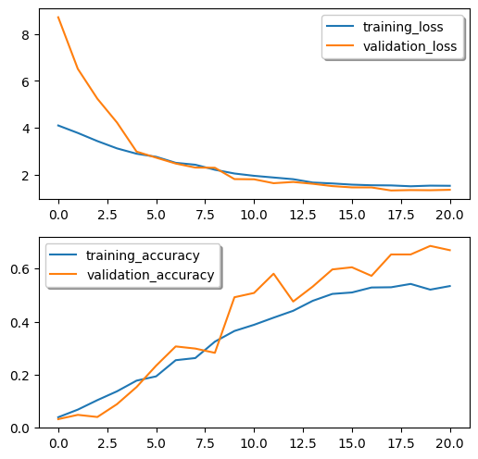
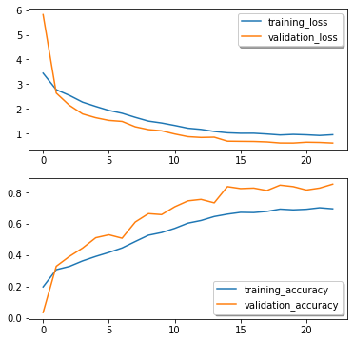
Training Phase: Accuracy and Loss Visualization
Only rotation
more augmentation

Slide 19
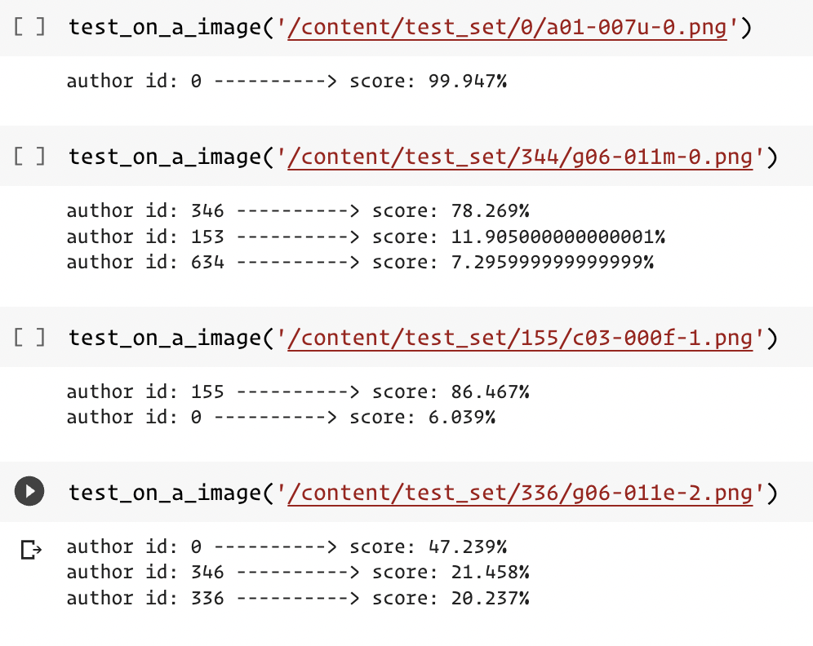
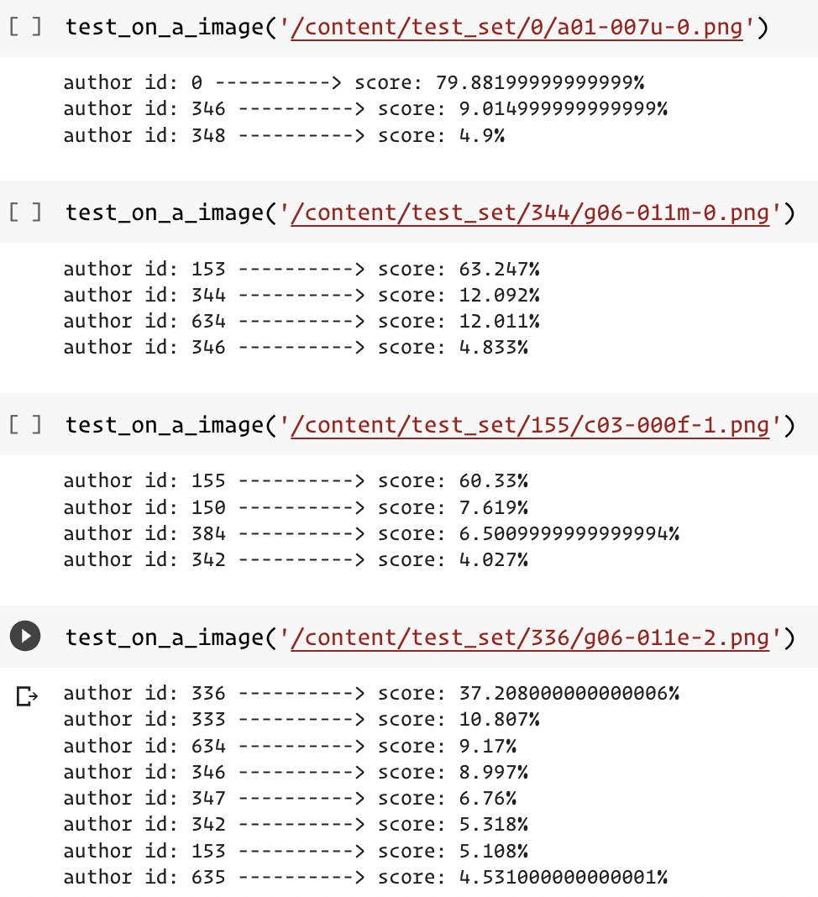
more augmentation
Only rotation
higher score of similarity
More mistakes :(
the score of similarity is not quite high.
The true identity is in the returned list
First interpretation: Only rotation performs better BUT..

Slide 20
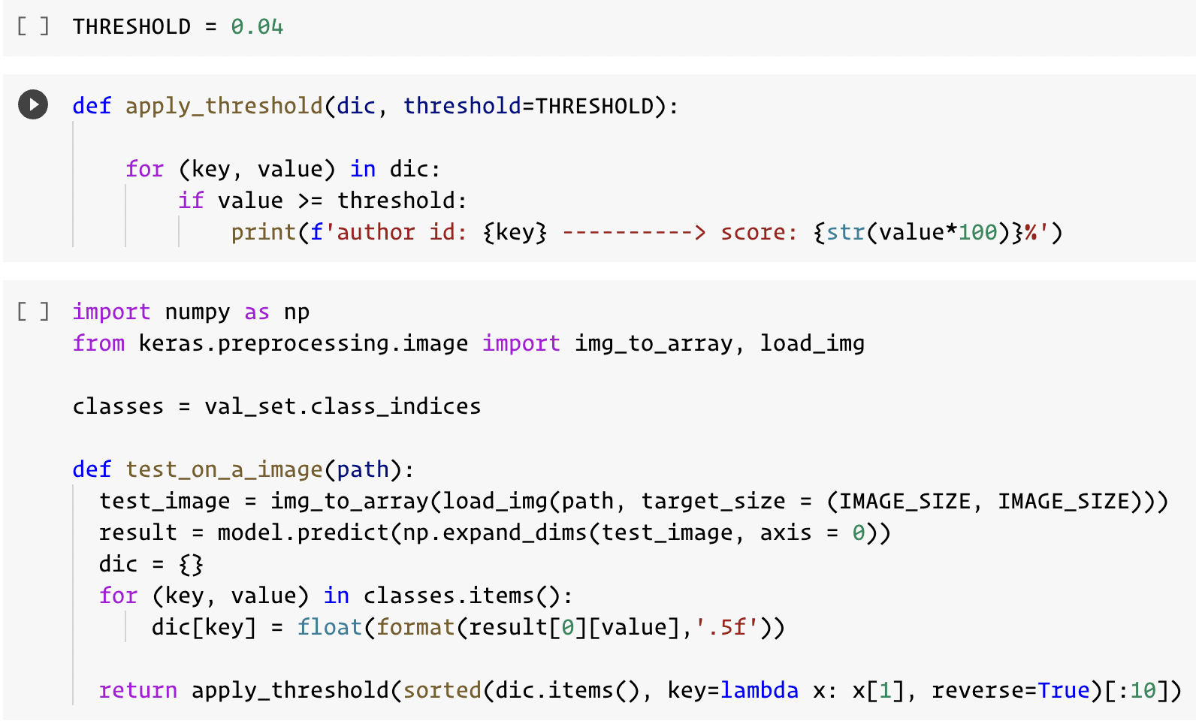
Training Phase: Test Set Accuracy
Predicting the identity of the given image using a function based on Machine Learning on Testing set
Accuracy over the test set in the case of:
solo rotation model → 44.89%
With more augmentation → 63.17%
More augmentation model has a higher accuracy over all images, means that performs better than solo rotation one
Model | Loss | Accuracy
Solo Rotation | 1.8915 | 44.89%
More Augmentation | 1.3178 | 63.17%

Slide 21

04
Evaluation

Slide 22
Evaluation:
Remove last layer(classification) to access the feature layer
The goal is to create a similarity matrix (372 x 372) which:
Has 31 identities, each of them has 12 templates(31 x 12 = 372)
Each row (we have 372 rows) is a 31 recognition operation
In the column, we have 372 templates
Each row contains 1 genuine claim
Each row contains N_identities - 1 imposters (30 operations)
For each operation we considered a group of templates with the same identity with maximum similarity. Then this similarity was compared with the given threshold. This is known as multiple-template verification in the literature.

Slide 23
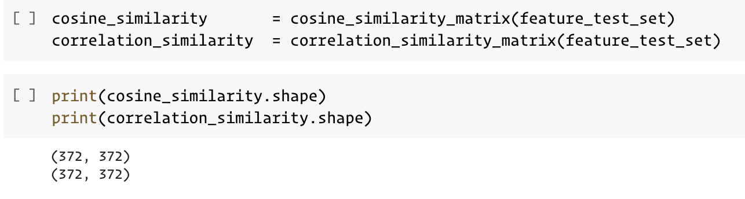
Evaluation:
To compare feature vectors with each other we defined two measures:
Cosine Similarity → had a better result in general
Correlation
As we had 372 feature vector, the matrix of the correlation and similarity is 372x372
The matrix gives us the ability to perform an all-against-all biometric evaluation task

Slide 24
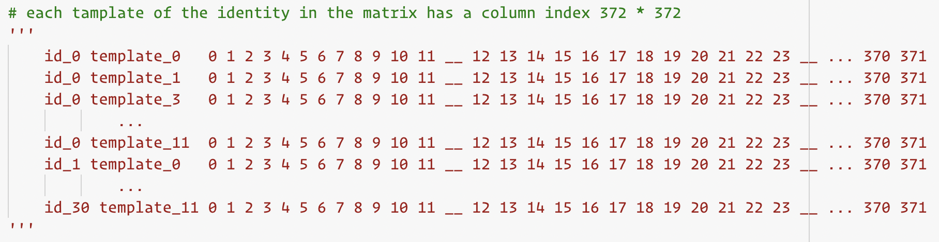
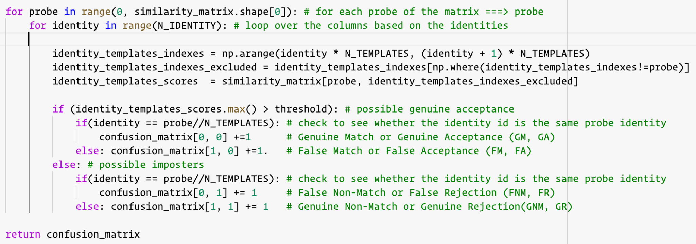
Similarity Matrix

Slide 25
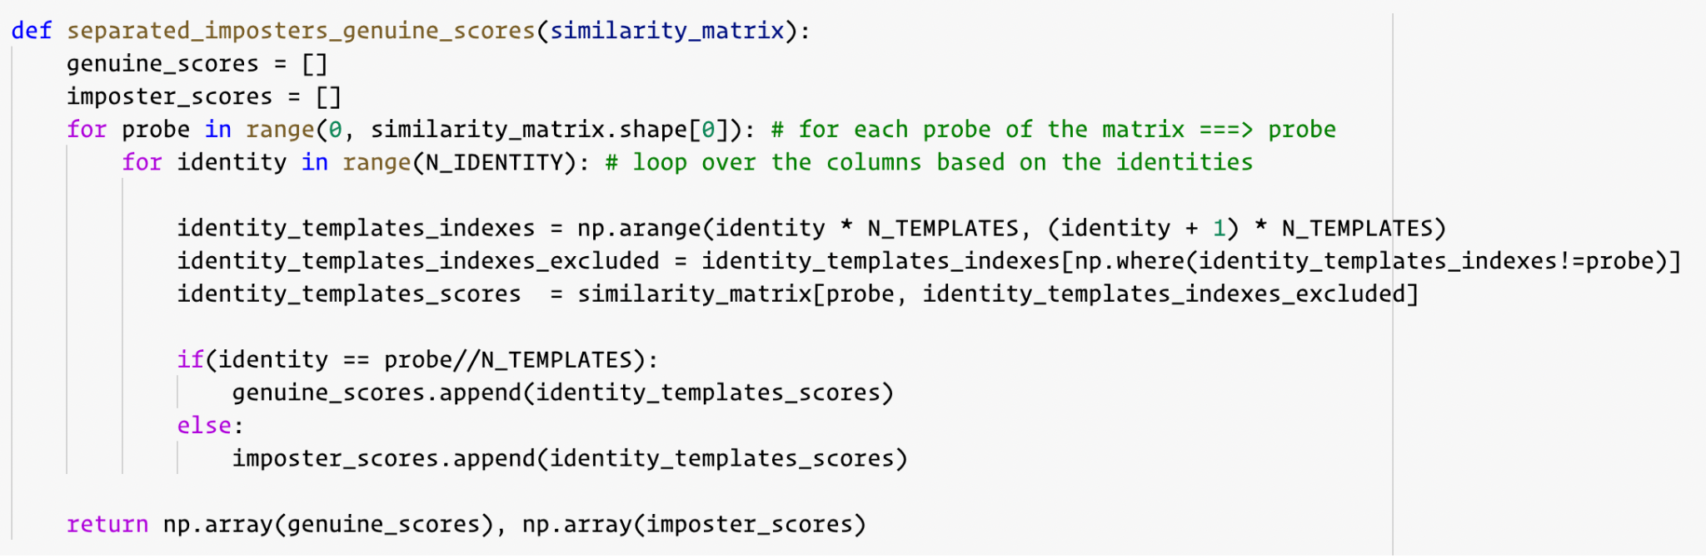
Evaluation:
We need to identify all the thresholds to perform a full evaluation of the biometric
pyeer library:
is using two different scores as the input:
One corresponds to imposter scores
The other is the genuine scores

Slide 26
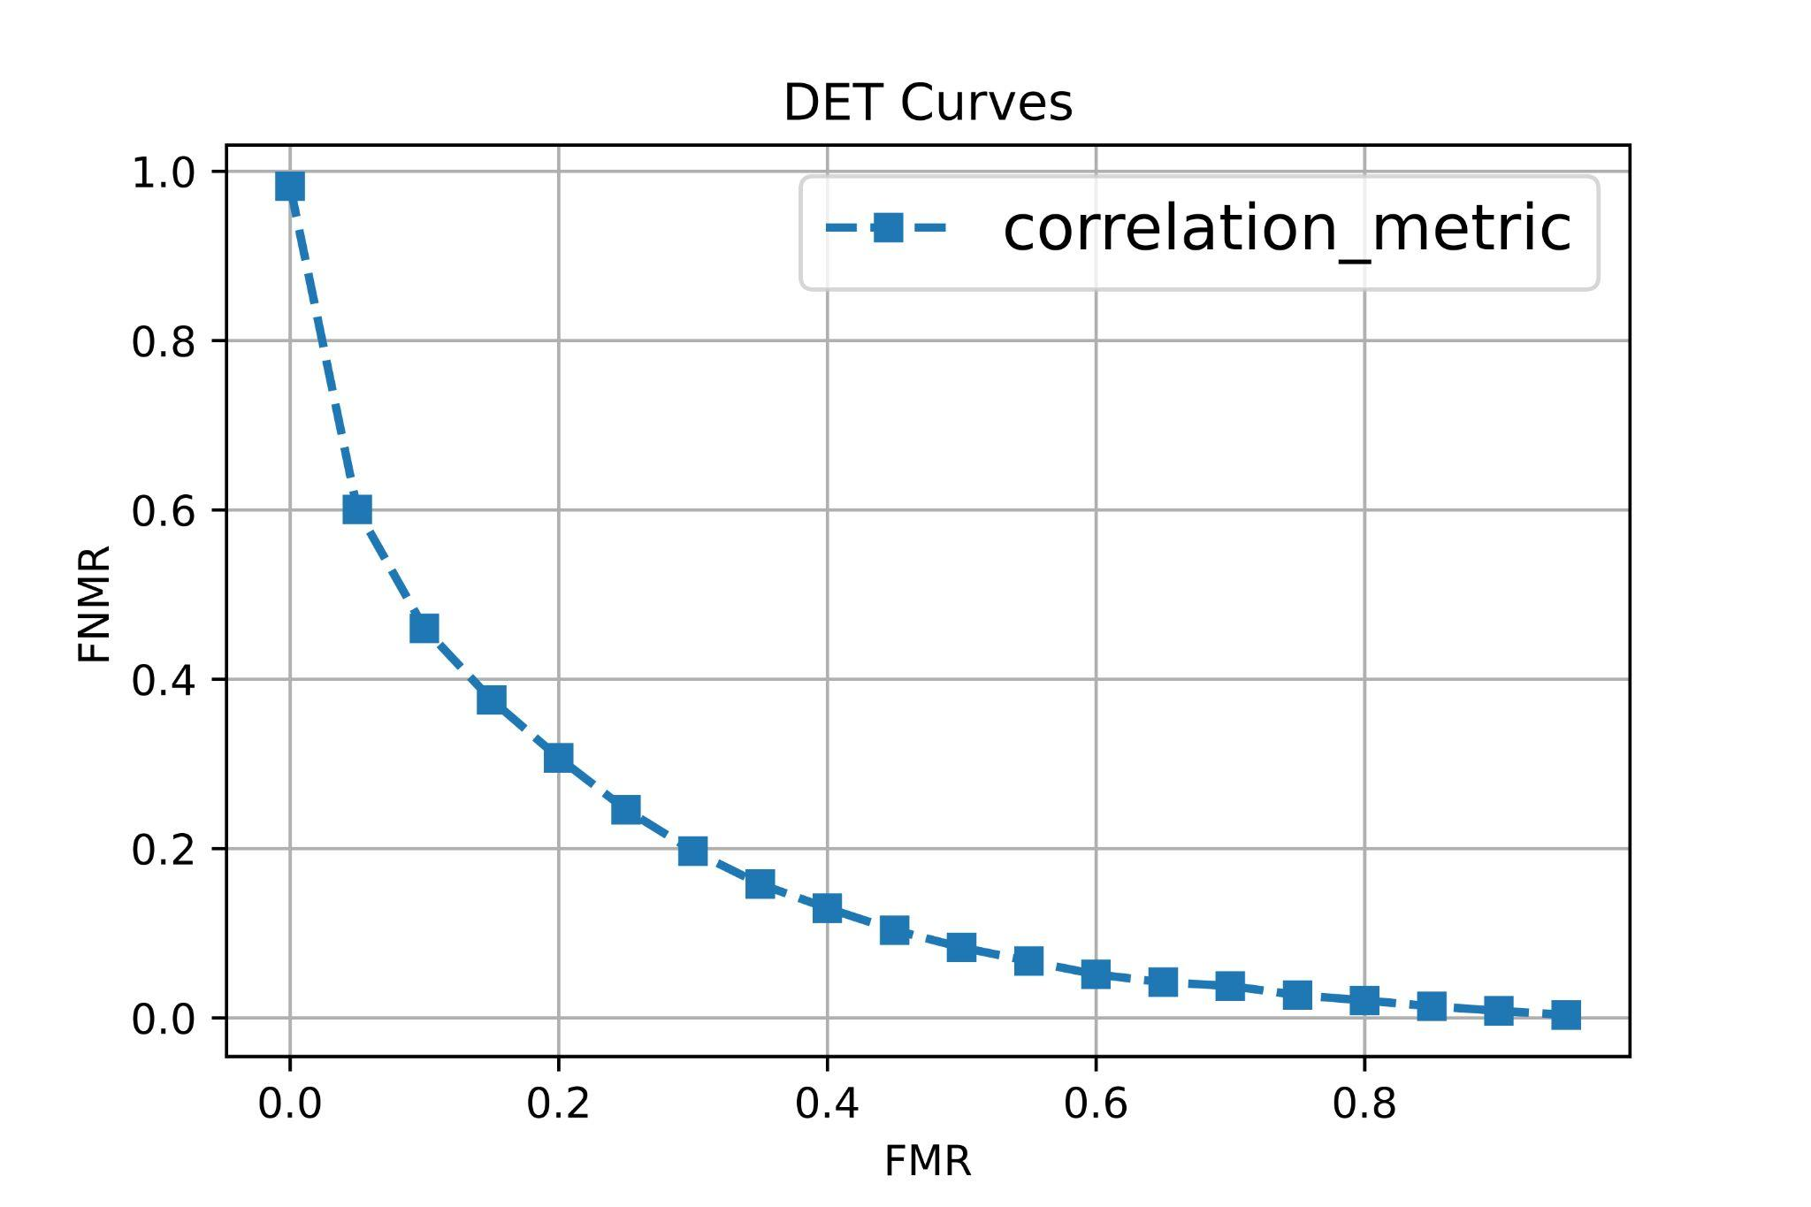
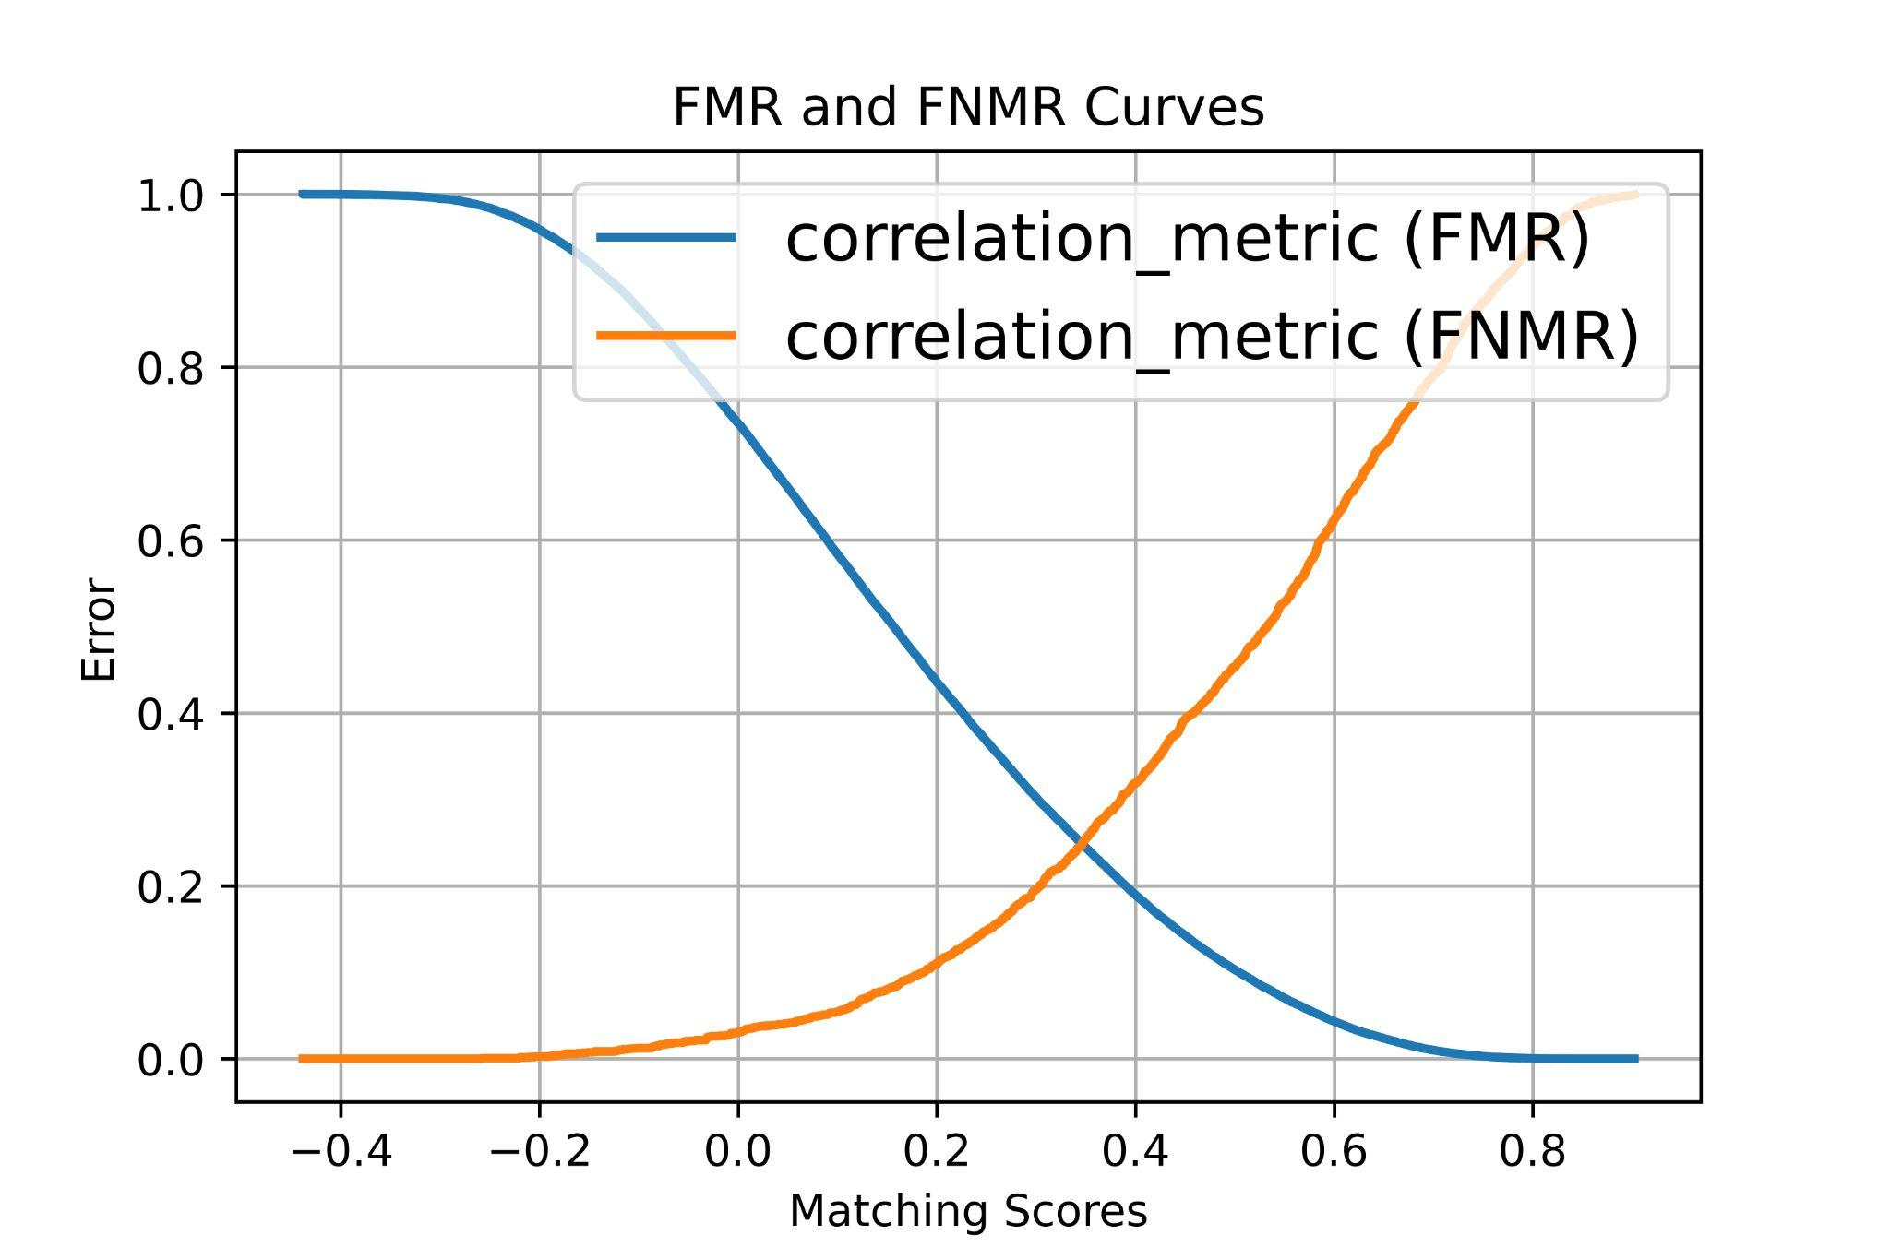
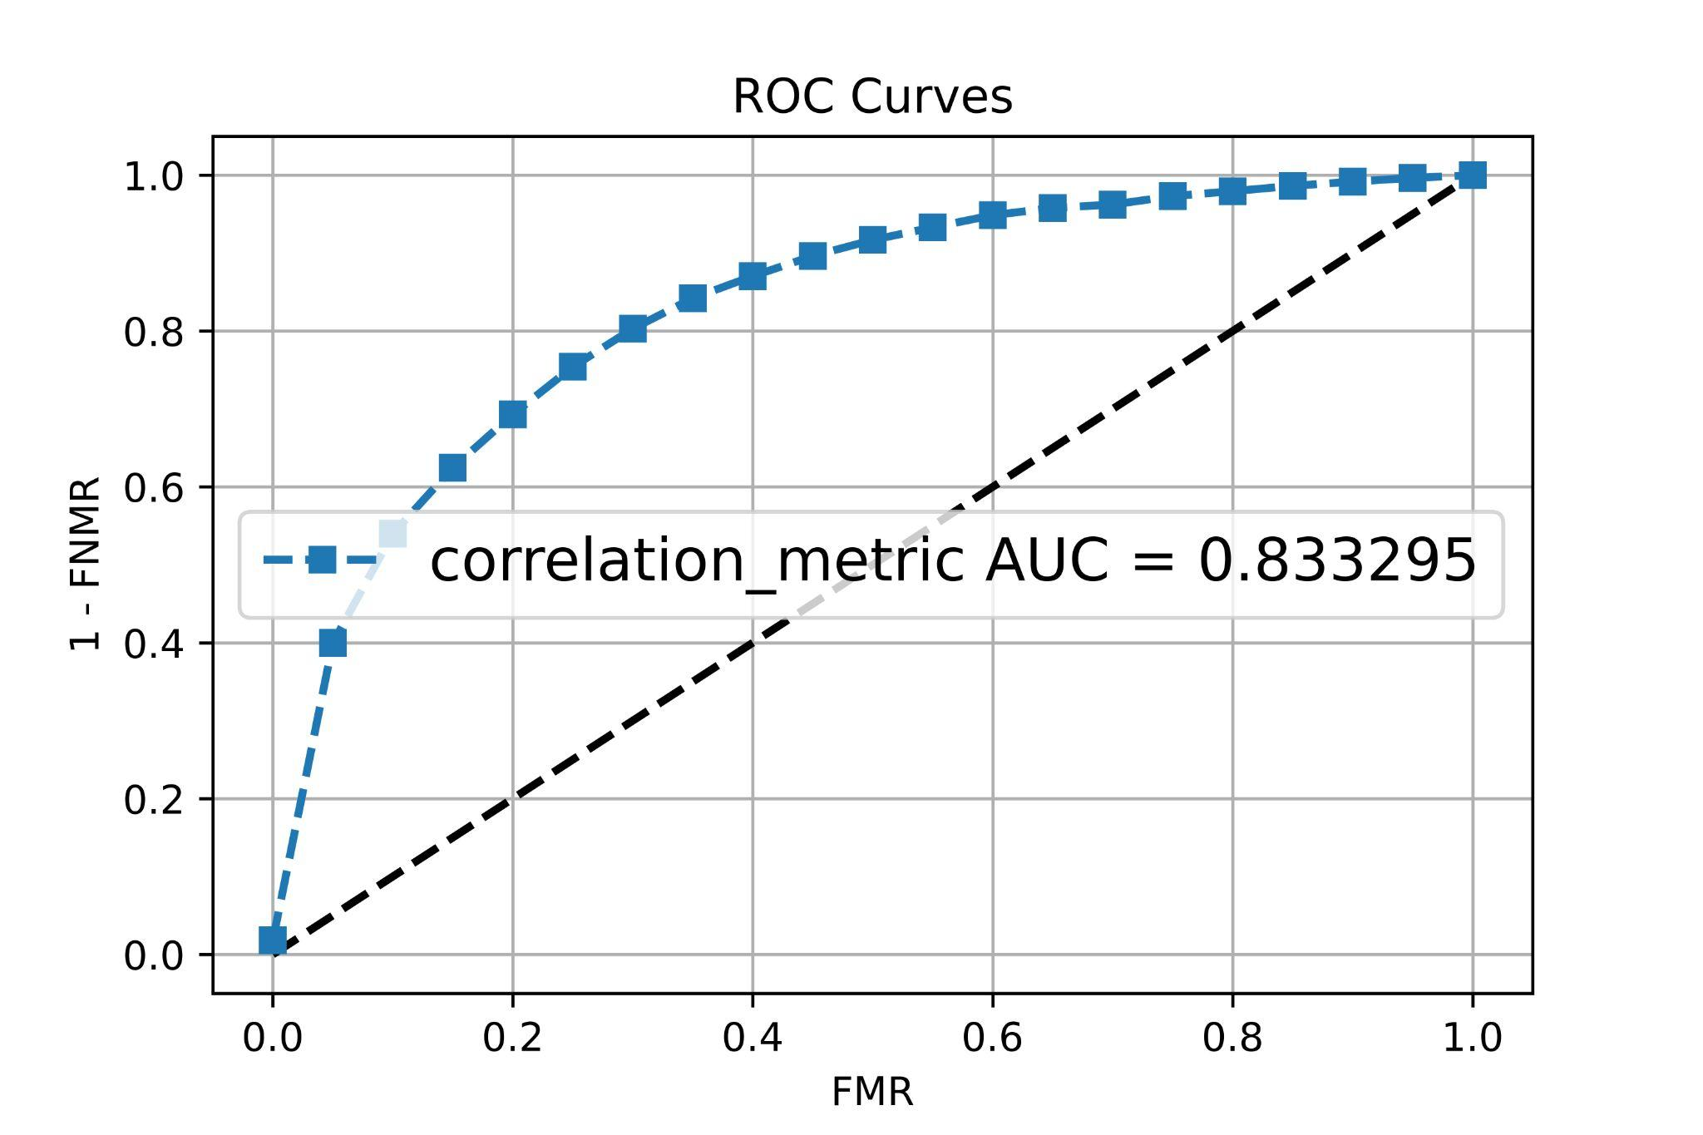
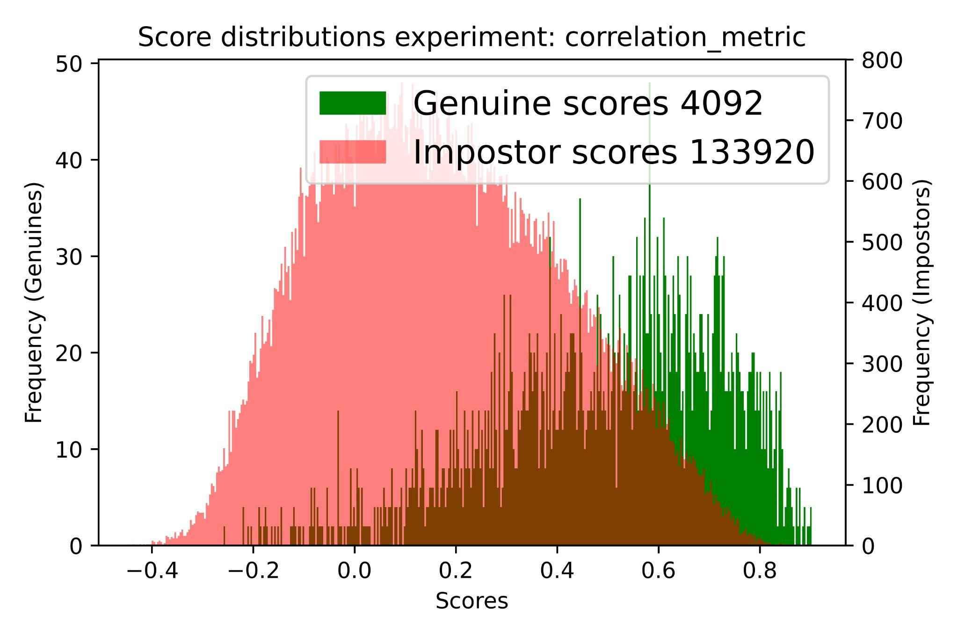
Model with no augmentation:
Results are not much satisfactory
According to the distribution figure, the overlap part is where we have wrong scores

Slide 27
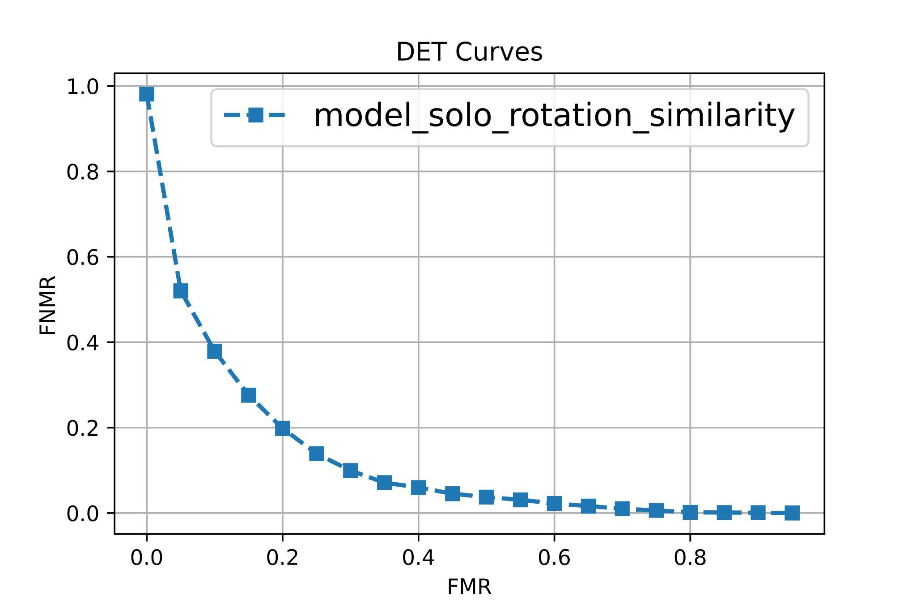
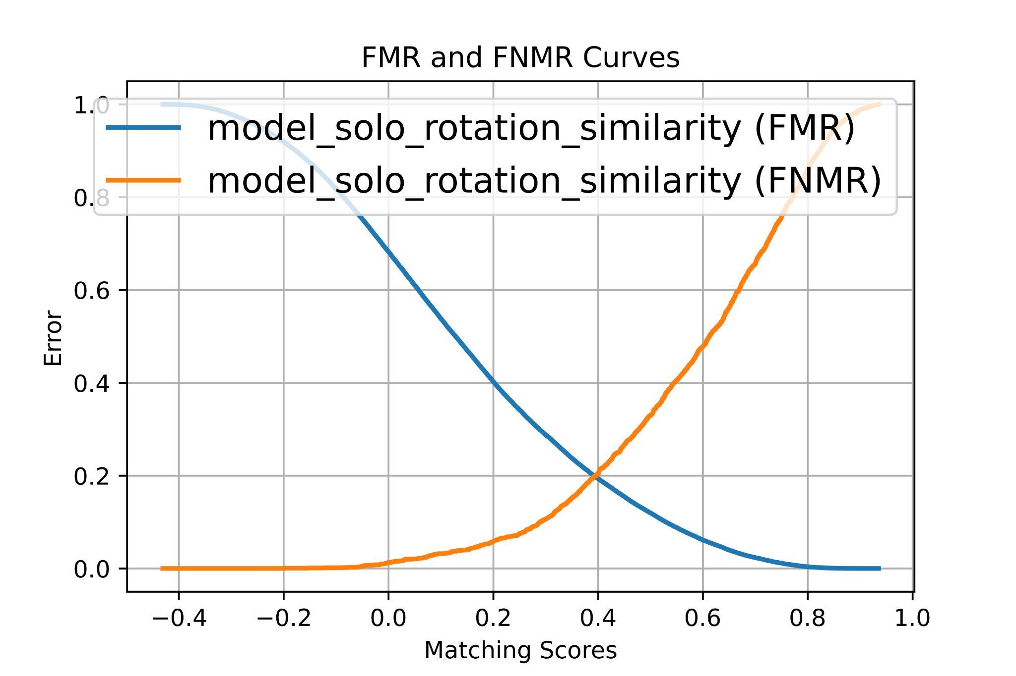
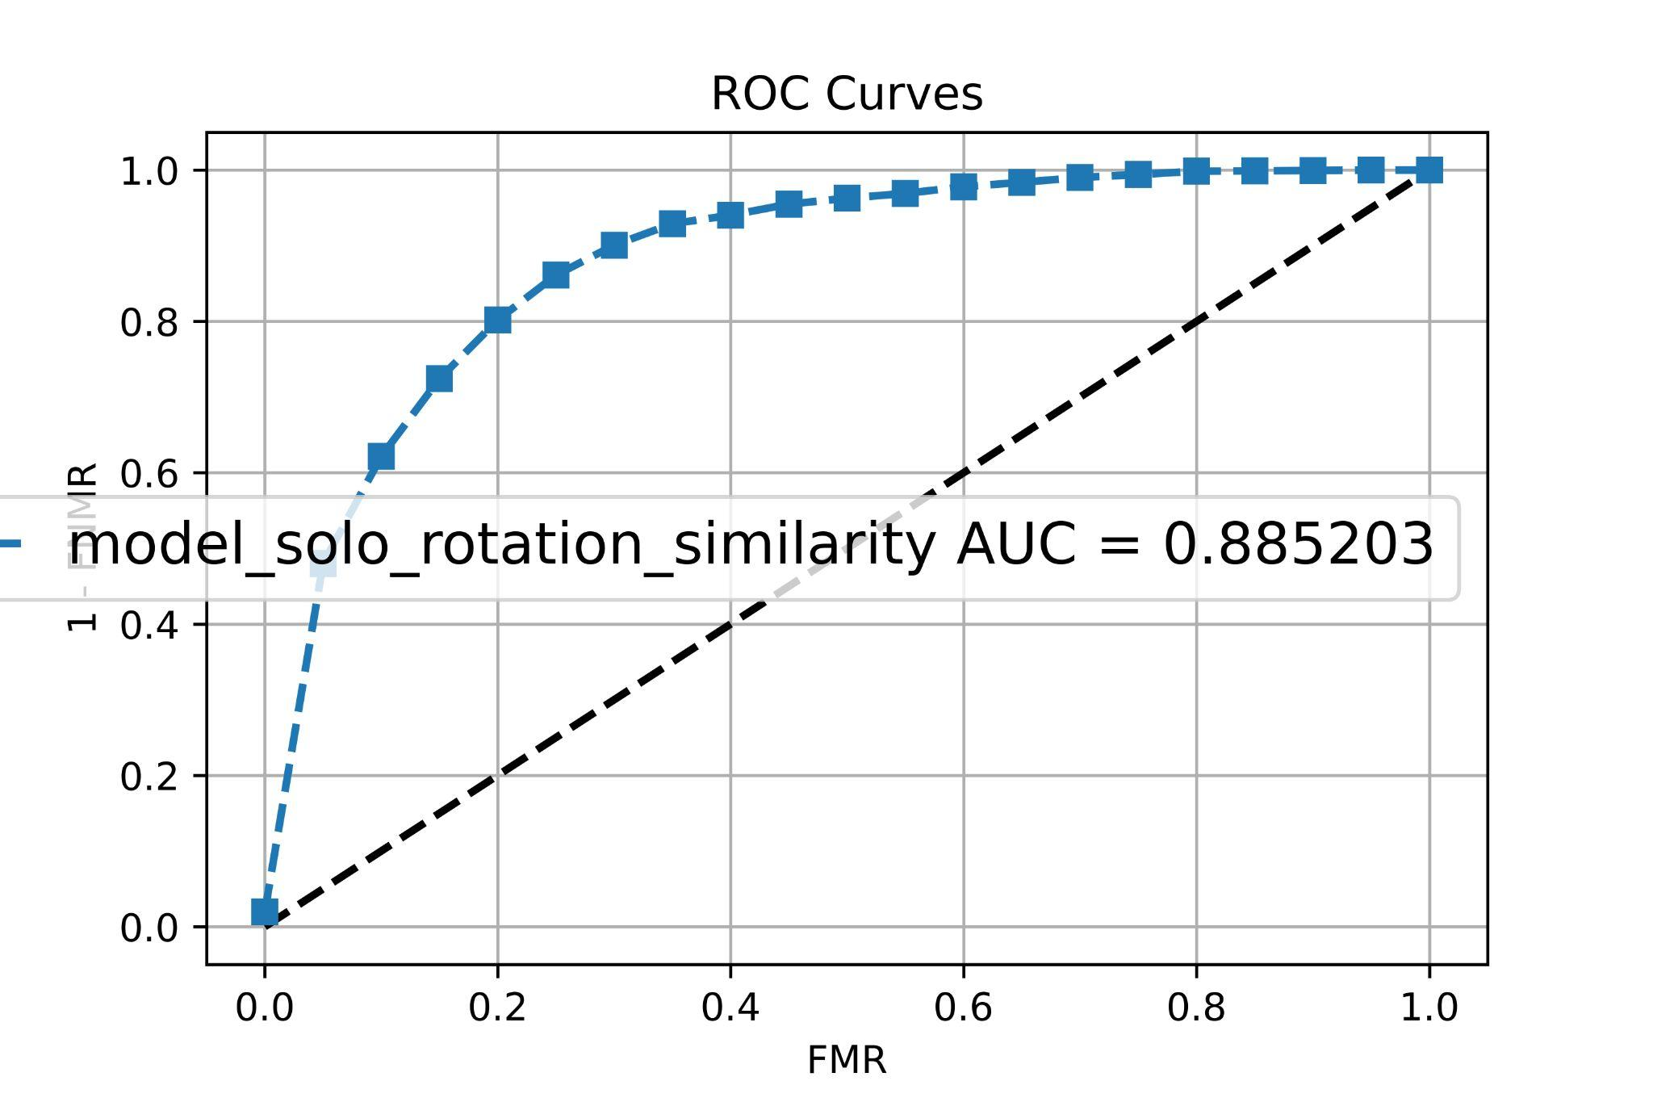
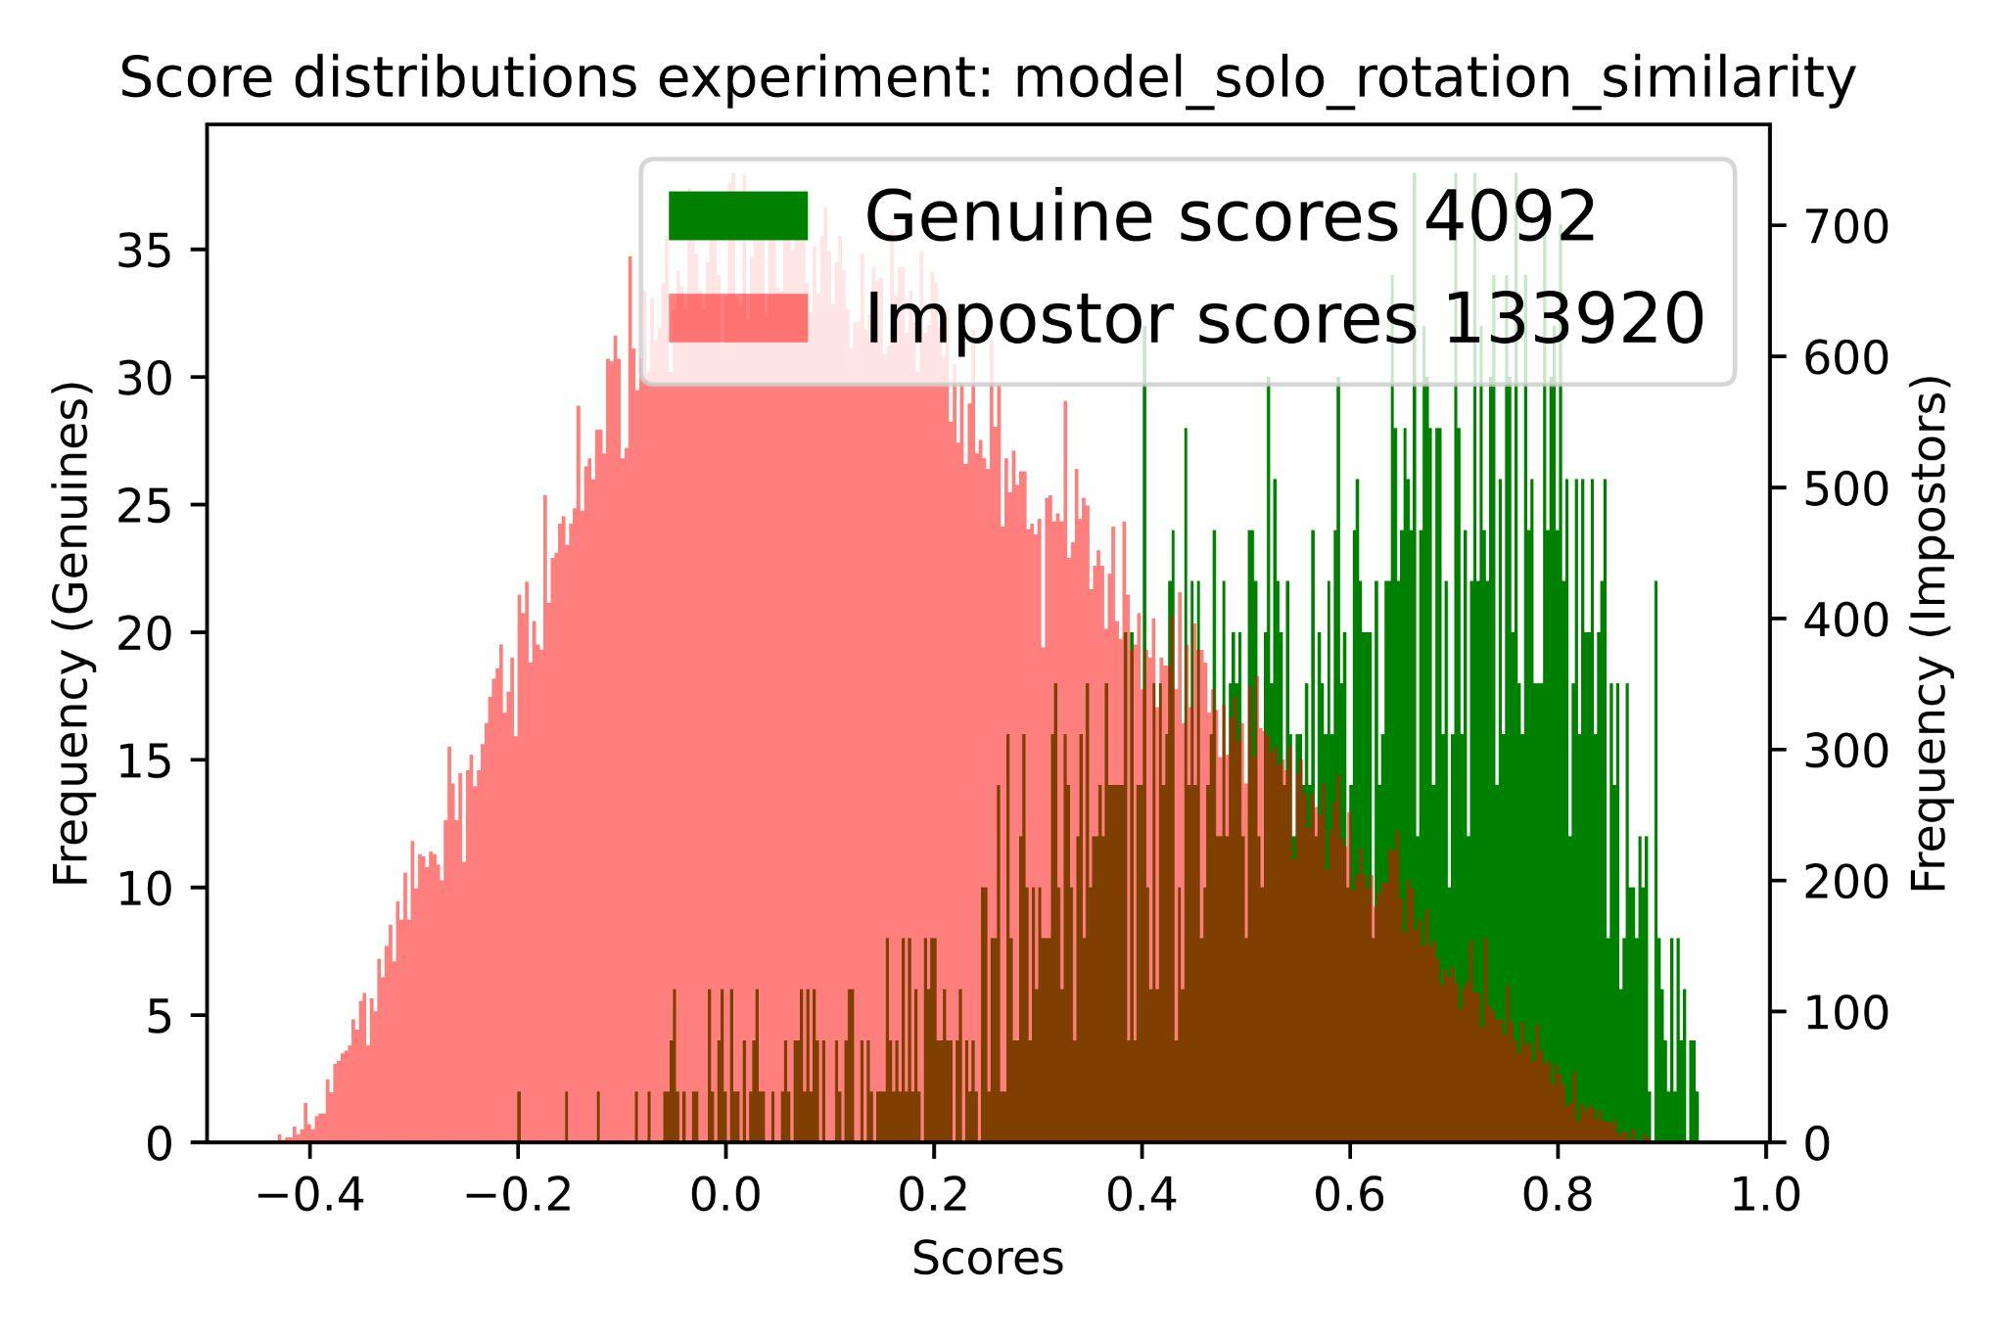
Model with solo rotation:
Better result w.r.t. the previous one both in cosine and correlation measures
Cosine similarity had a better result in this case
Adding more augmentation options could be effective to increase the performance
the EER in the right picture is equal to 0.2 which is better than the previous model
AUC: 0.83 → 0.88

Slide 28
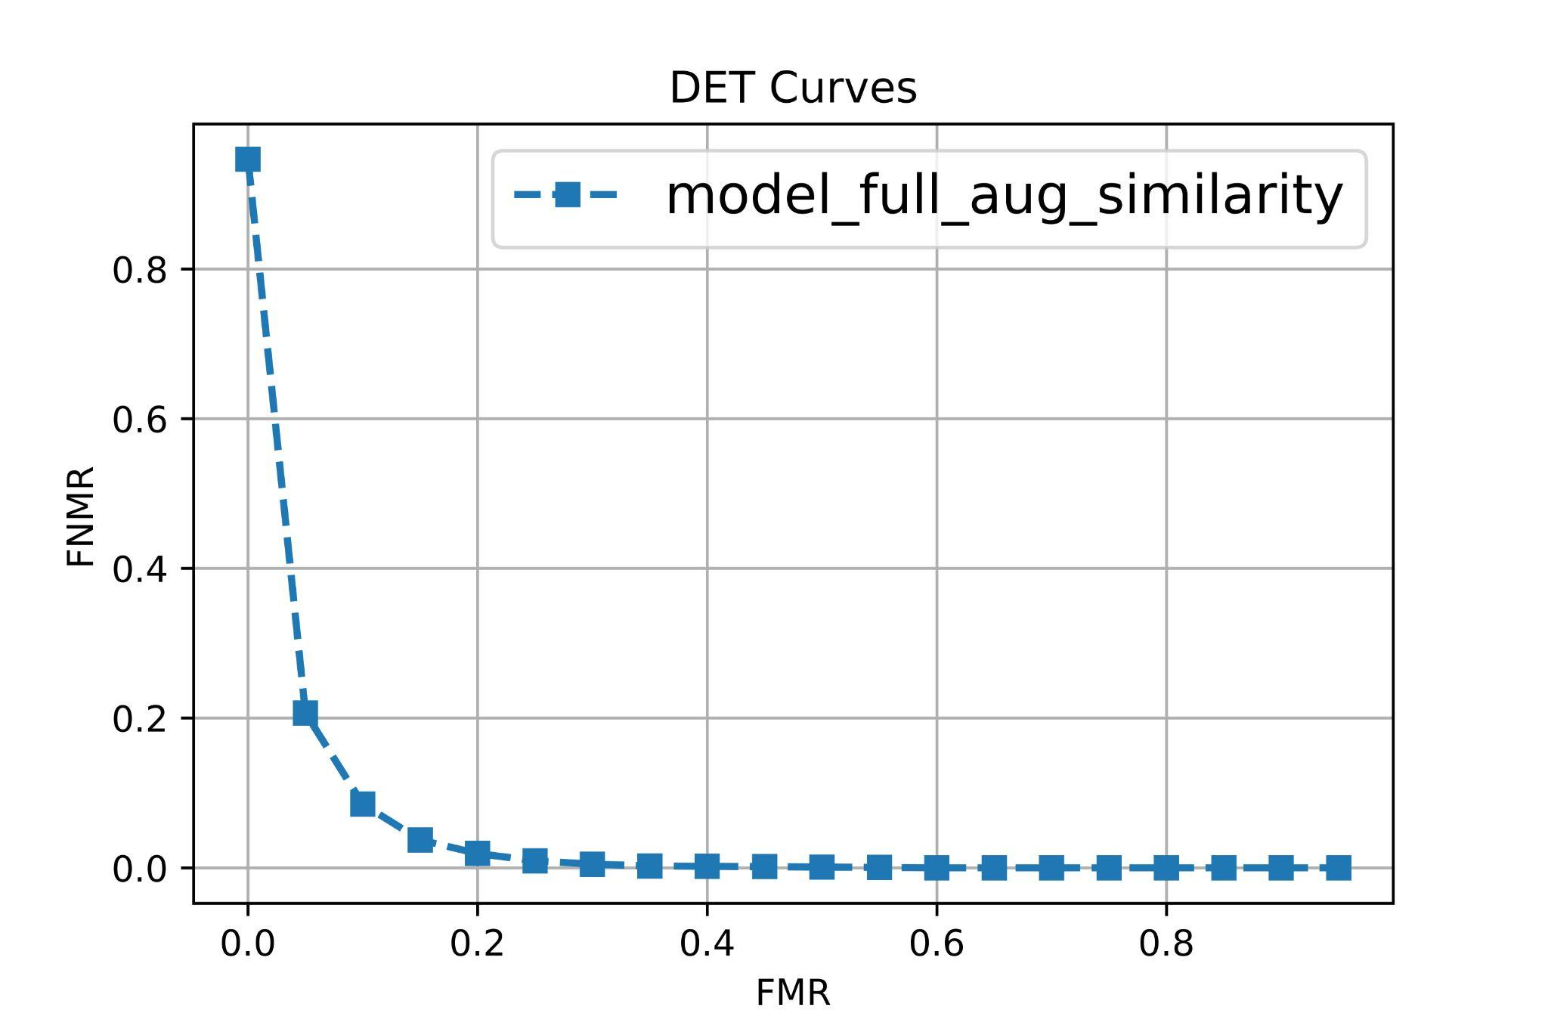
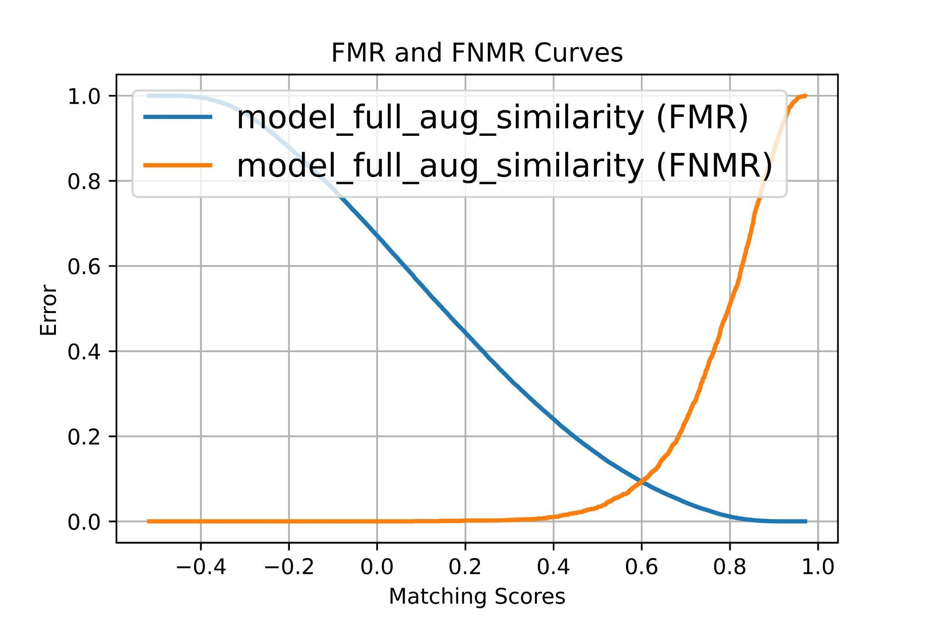
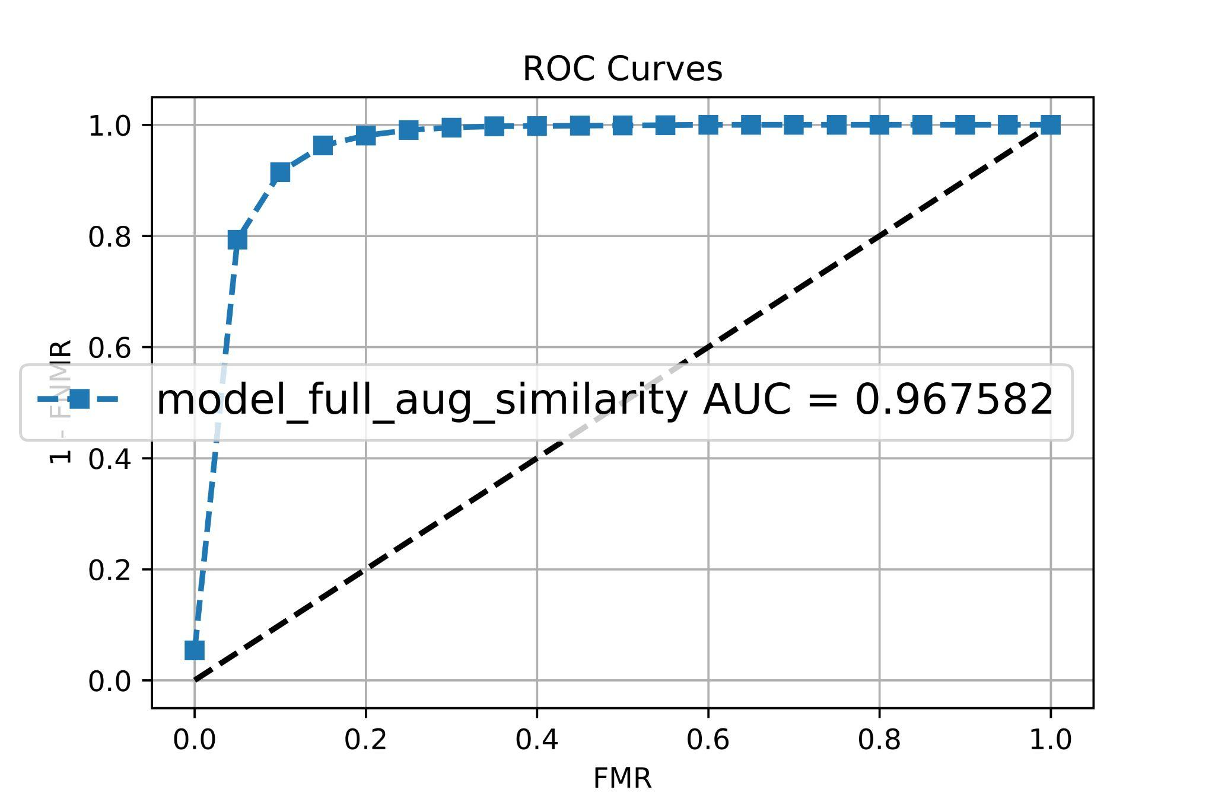
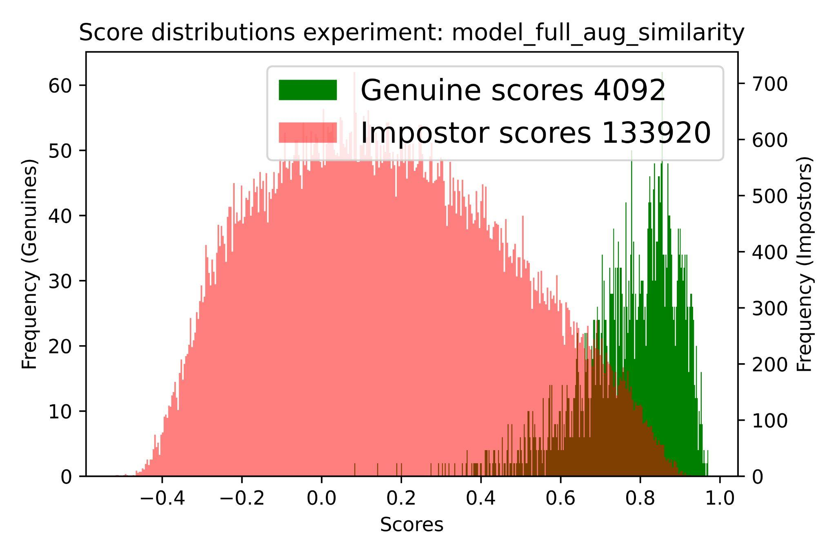
Model with more augmentation:
The best model based on the evaluation result
The EER also dropped drastically to a lower value (almost 0.1)
The AUC is now equal to almost 0.97 which is quite impressive due to the nature of the task
The overlap part also reduced dramatically compared to the previous ones

Slide 29
Thanks for your attention!
Any Questions?
teymoori.1947458@studenti.uniroma1.it
shabani.1966731@studenti.uniroma1.it
June 2022

